Slide 1
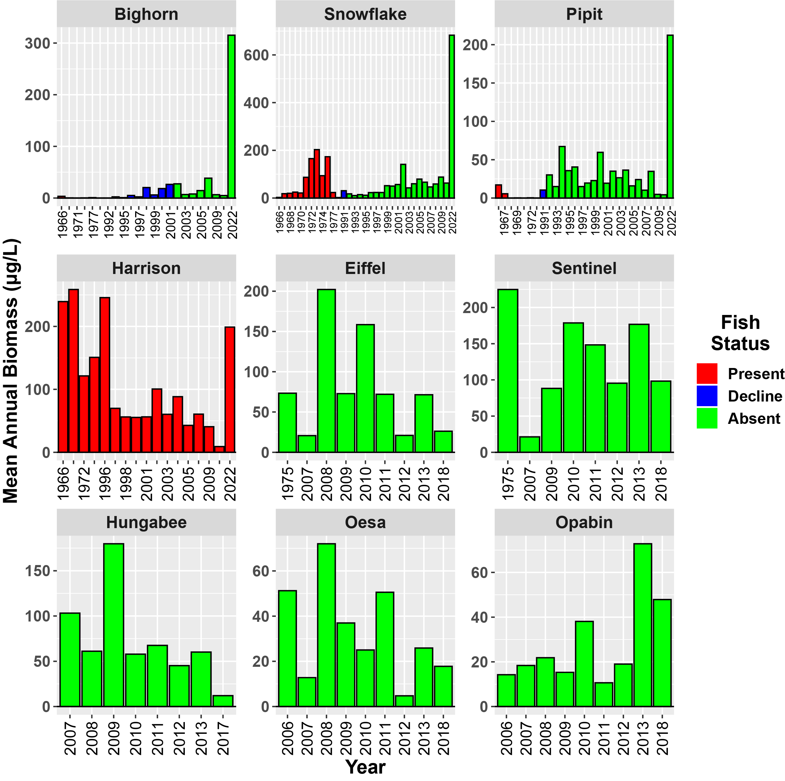
Mean Annual Zoop Biomass

Slide 2
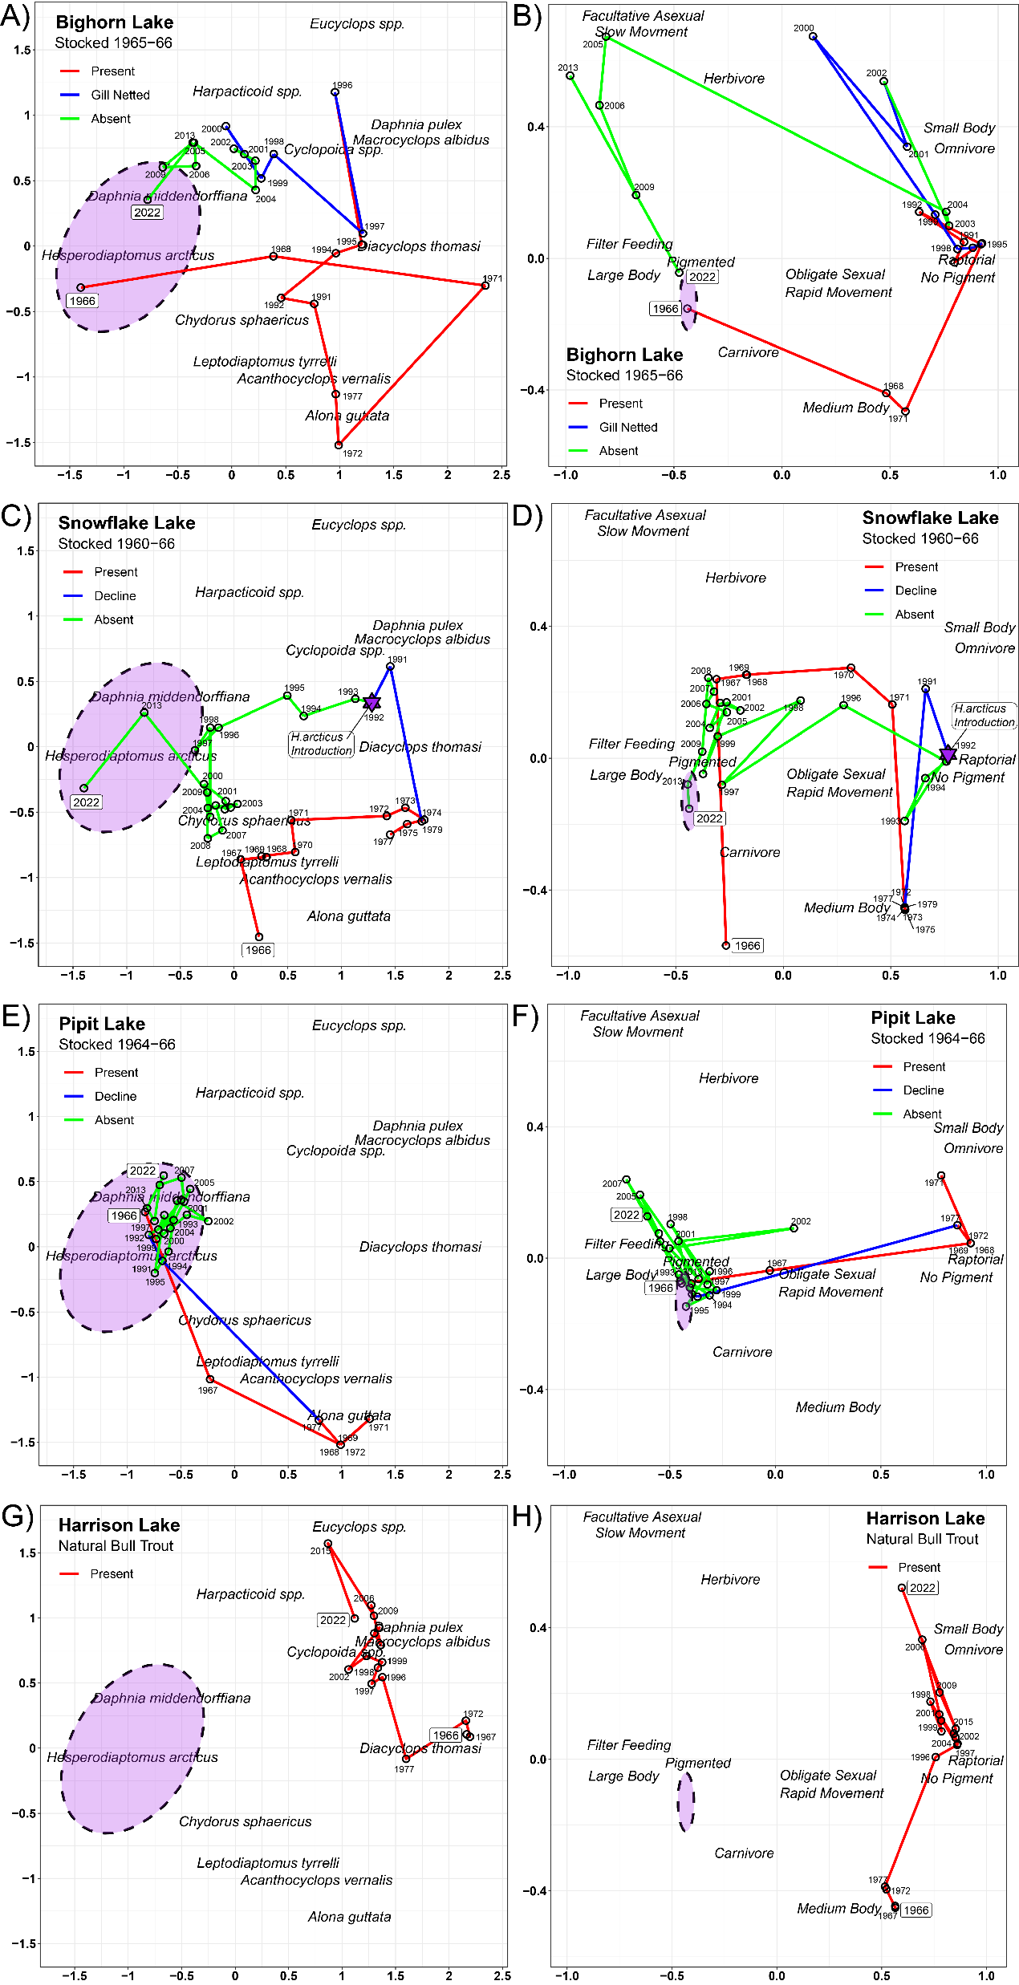
NMDS 2
NMDS 1
Notes:
GLOBAL TAXONOMIC ORDINATION STATS
global Multidimensional Scaling using monoMDS
Data: wisconsin(sqrt(Casc22.abnd.78rm))
Distance: bray-curtis
Dimensions: 2
Stress: 0.1447521
Stress type 1, weak ties
Best solution was repeated 1 time in 140 tries
The best solution was from try 140 (random start)
Scaling: centring, PC rotation, halfchange scaling wisconsin(sqrt(Casc22.abnd.78rm))’
Species scores: expanded scores based on ‘GLOBAL CWM-TRAIT ORDINATION STATS
global Multidimensional Scaling using monoMDS
Data: CWM.traits.all.78rm
Distance: bray-curtis
Dimensions: 2
Stress: 0.0594078
Stress type 1, weak ties
Best solution was repeated 1 time in 20 tries
The best solution was from try 0 (metric scaling or null solution)
Scaling: centring, PC rotation, halfchange scaling
TRAITs scores: expanded scores based on ‘CWM.traits.all.78rm’

Slide 3
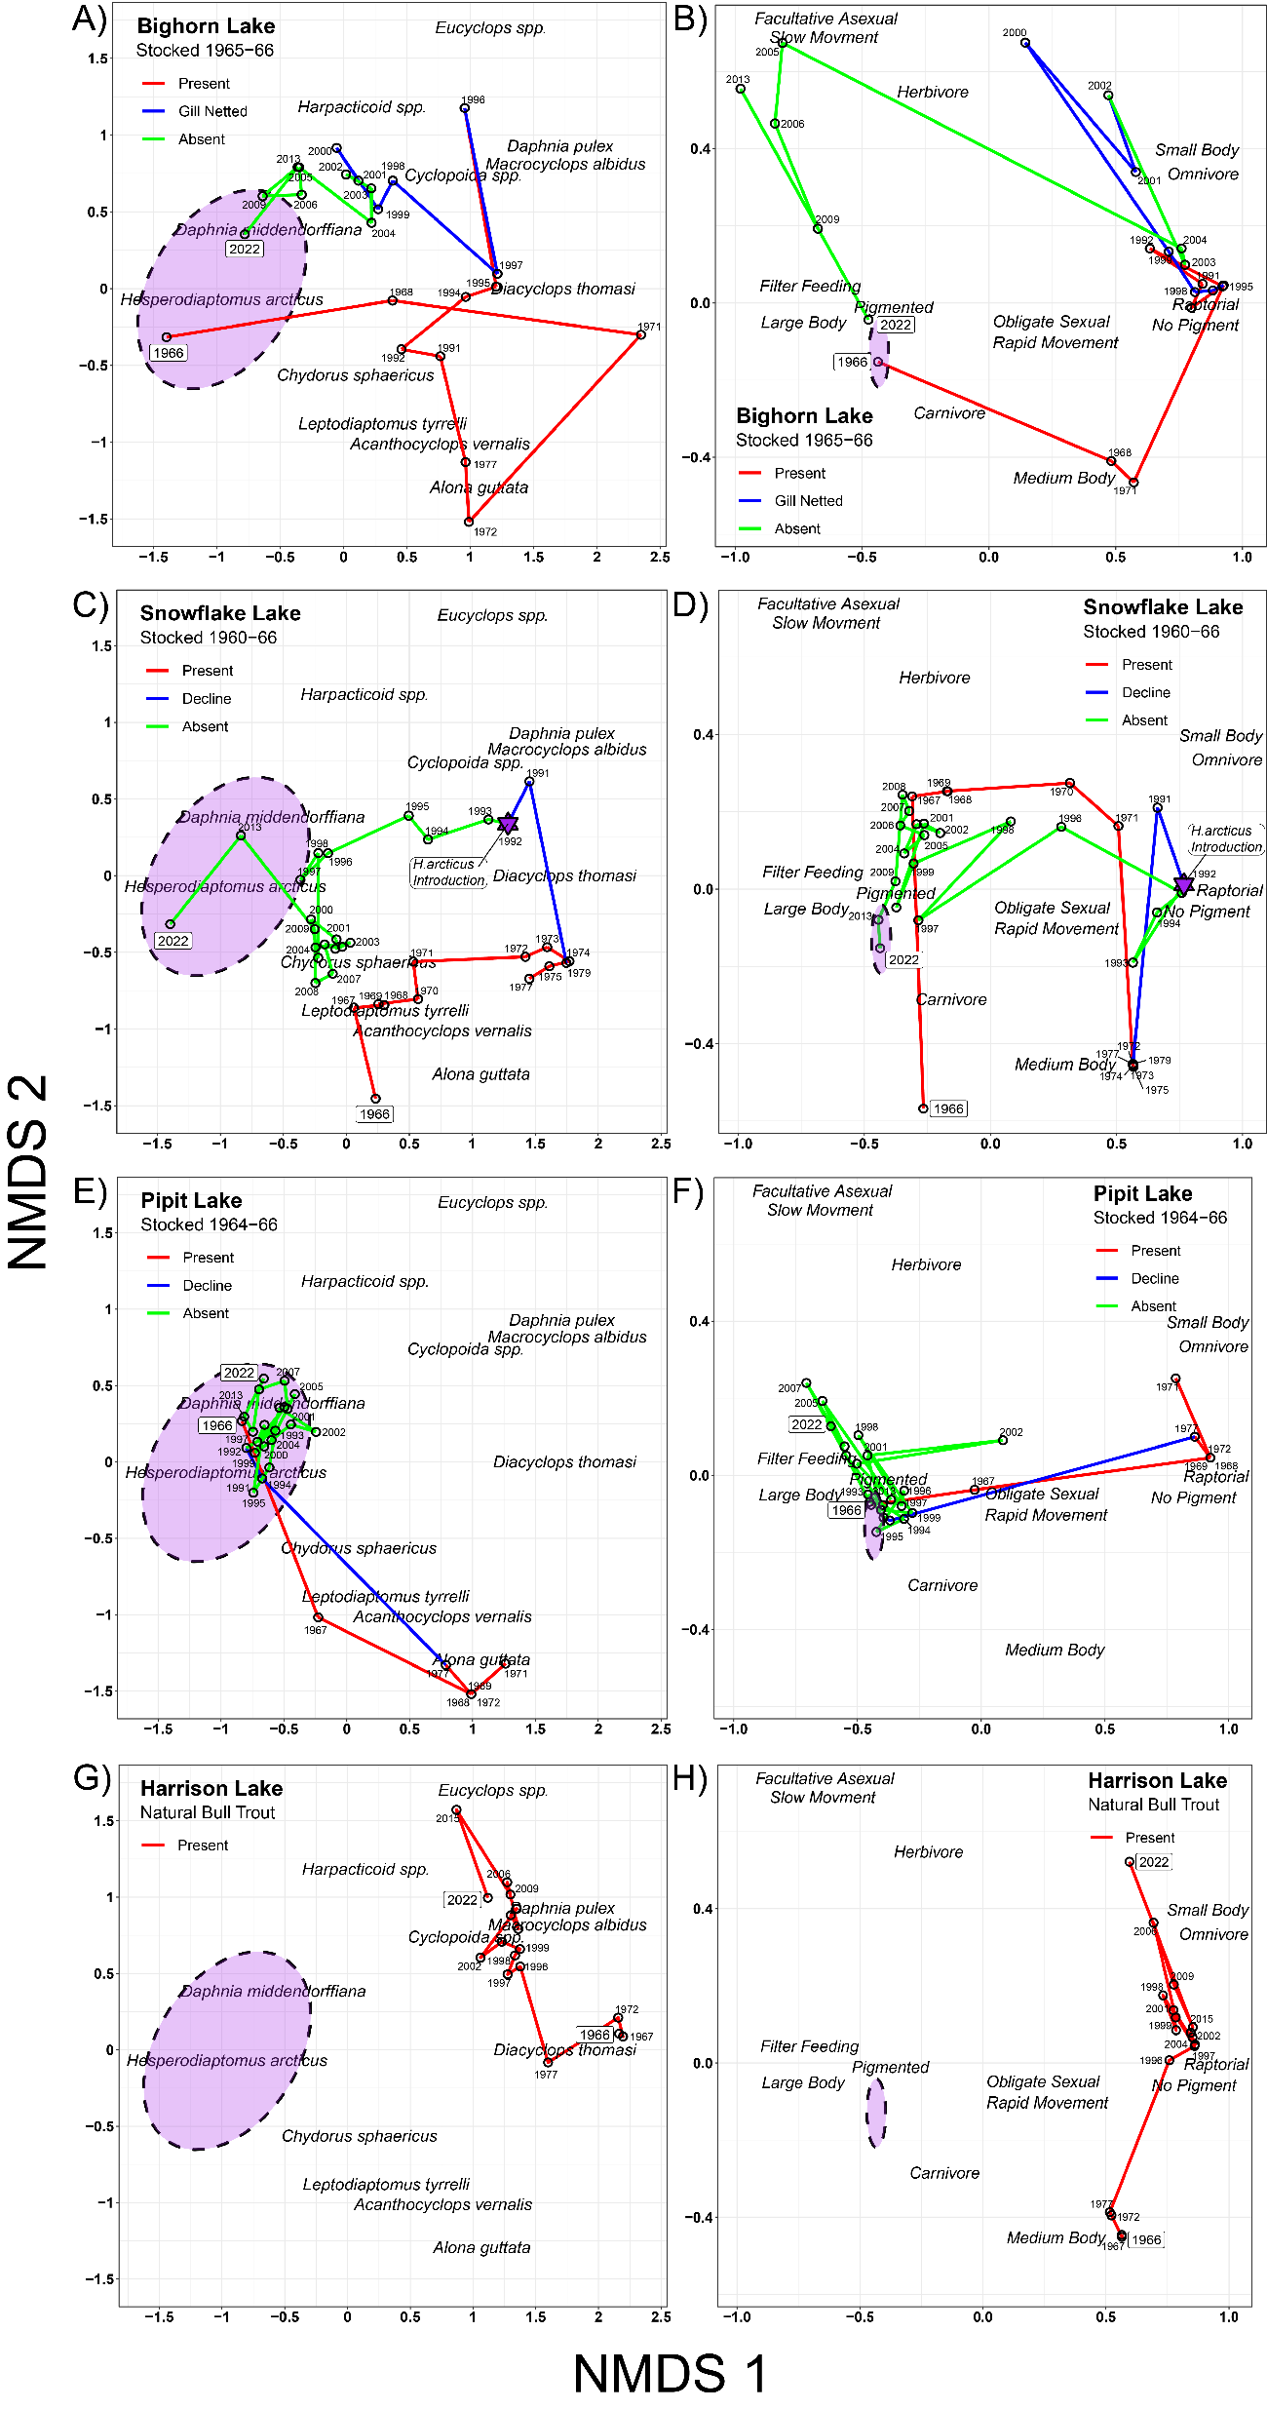
Notes:
GLOBAL TAXONOMIC ORDINATION STATS
global Multidimensional Scaling using monoMDS
Data: wisconsin(sqrt(Casc22.abnd.78rm))
Distance: bray-curtis
Dimensions: 2
Stress: 0.1447521
Stress type 1, weak ties
Best solution was repeated 1 time in 140 tries
The best solution was from try 140 (random start)
Scaling: centring, PC rotation, halfchange scaling wisconsin(sqrt(Casc22.abnd.78rm))’
Species scores: expanded scores based on ‘GLOBAL CWM-TRAIT ORDINATION STATS
global Multidimensional Scaling using monoMDS
Data: CWM.traits.all.78rm
Distance: bray-curtis
Dimensions: 2
Stress: 0.0594078
Stress type 1, weak ties
Best solution was repeated 1 time in 20 tries
The best solution was from try 0 (metric scaling or null solution)
Scaling: centring, PC rotation, halfchange scaling
TRAITs scores: expanded scores based on ‘CWM.traits.all.78rm’

Slide 4
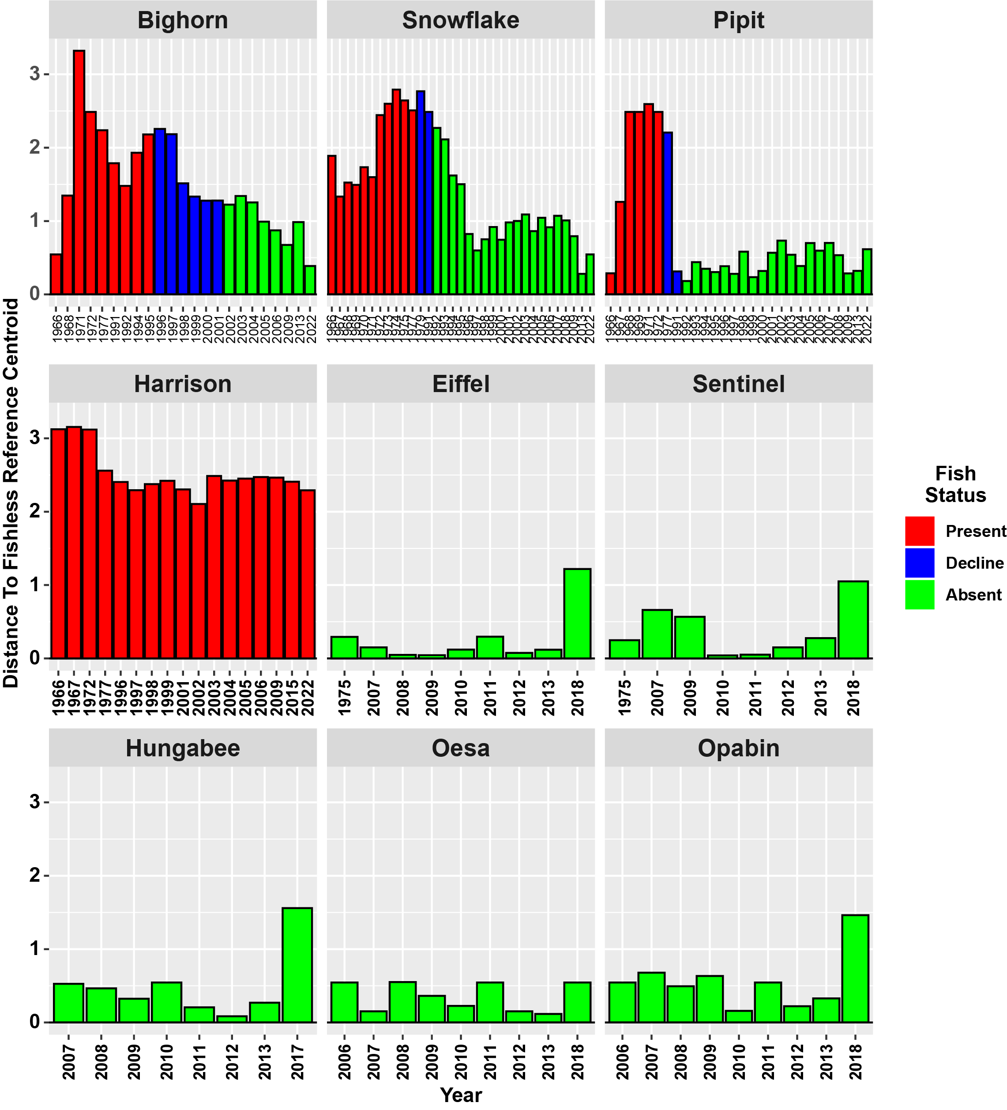
Taxonomic Distances

Slide 5
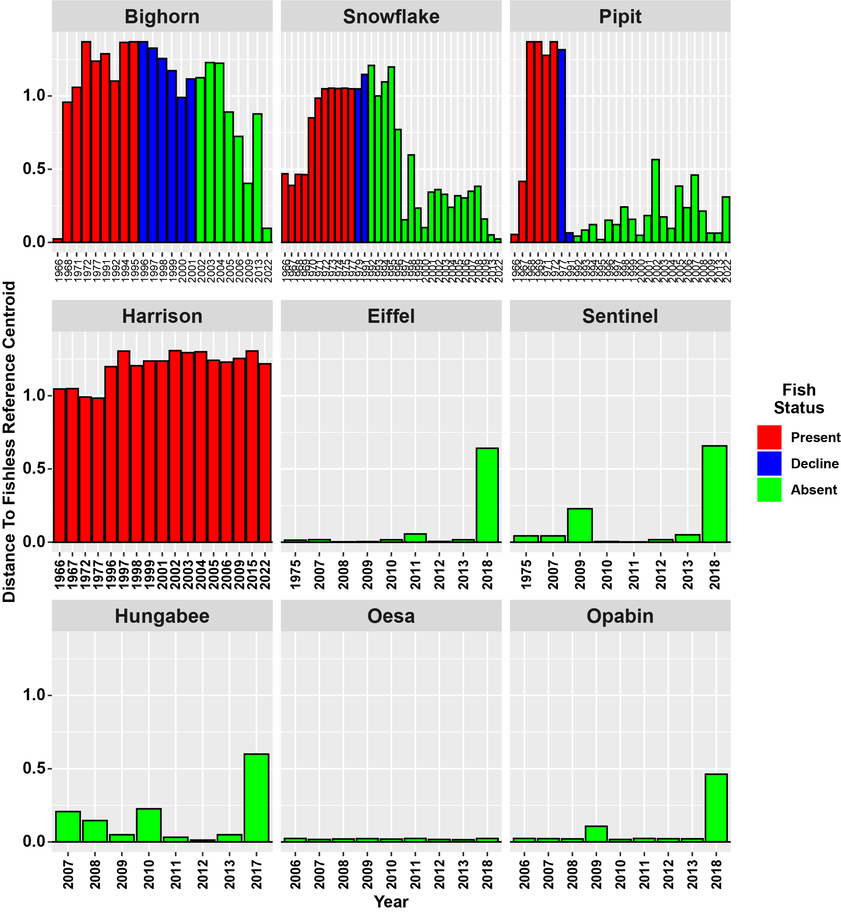
Trait Distances

Slide 6
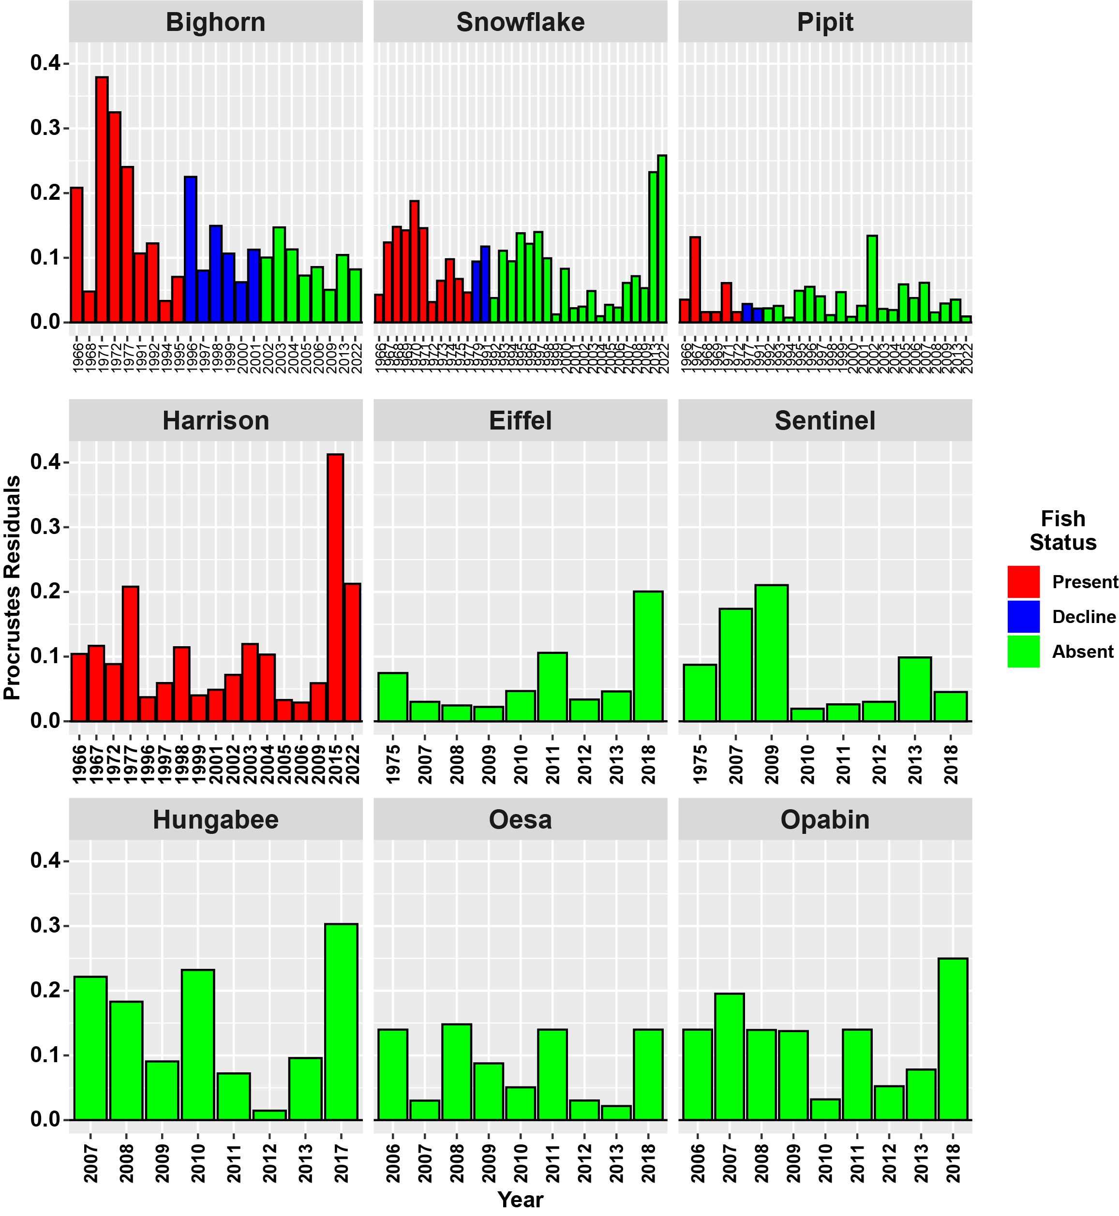
Procrustes residuals (Traits -> Taxonomic)
Notes:
BIGHORN LAKE PROCRUSTES:
Procrustes Sum of Squares (m12 squared): 0.569584
Correlation in a symmetric Procrustes rotation: 0.656061
Significance: 0.002
Permutation: free
Number of permutations: 999
Residuals
Big66 0.20818415
Big68 0.04789317
Big71 0.37899627
Big72 0.32492004
Big77 0.24041118
Big91 0.10683235
Big92 0.12228207
Big94 0.03326074
Big95 0.07055531
Big96 0.22503684
Big97 0.08013092
Big98 0.14935222
Big99 0.10649912
Big00 0.06227865
Big01 0.11260564
Big02 0.10039663
Big03 0.14703952
Big04 0.11291266
Big05 0.07250480
Big06 0.08562515
Big09 0.05050003
Big13 0.10432669
Big22 0.08215161
PIPIT LAKE PROCRUSTES:
Procrustes Sum of Squares (m12 squared): 0.0657123
Correlation in a symmetric Procrustes rotation: 0.966586
Significance: 0.001
Permutation: free
Number of permutations: 999
Residuals
Pip66 0.035466419
Pip67 0.131842075
Pip68 0.016163439
Pip69 0.016163439
Pip71 0.060937835
Pip72 0.016163439
Pip77 0.028605436
Pip91 0.021609580
Pip92 0.021891795
Pip93 0.025693229
Pip94 0.007572139
Pip95 0.049094746
Pip96 0.055261860
Pip97 0.040459326
Pip98 0.011446441
Pip99 0.046988737
Pip00 0.008774484
Pip01 0.025934262
Pip02 0.134011435
Pip03 0.020909053
Pip04 0.019377953
Pip05 0.058909927
Pip06 0.037920870
Pip07 0.061385736
Pip08 0.015667216
Pip09 0.029410541
Pip13 0.035423595
Pip22 0.009469434
SNOWFLAKE LAKE PROCRUSTES:
Procrustes Sum of Squares (m12 squared): 0.390189
Correlation in a symmetric Procrustes rotation: 0.780904
Significance: 0.001
Permutation: free
Number of permutations: 999
Residuals
Sno66 0.042827981
Sno67 0.123743916
Sno68 0.147885769
Sno69 0.142385881
Sno70 0.187770710
Sno71 0.145891065
Sno72 0.031589763
Sno73 0.064507408
Sno74 0.097884286
Sno75 0.067382730
Sno77 0.046368384
Sno79 0.094160019
Sno91 0.117386279
Sno92 0.037914739
Sno93 0.110828683
Sno94 0.094732030
Sno95 0.137959579
Sno96 0.121763164
Sno97 0.139898486
Sno98 0.099234739
Sno99 0.012661255
Sno00 0.083064457
Sno01 0.022155604
Sno02 0.024566240
Sno03 0.048561616
Sno04 0.009798171
Sno05 0.027406159
Sno06 0.023086385
Sno07 0.061171436
Sno08 0.071681603
Sno09 0.053171879
Sno13 0.232437901
Sno22 0.258224172
HARRISON LAKE PROCRUSTES:
Procrustes Sum of Squares (m12 squared): 0.348426
Correlation in a symmetric Procrustes rotation: 0.807201
Significance: 0.001
Permutation: free
Number of permutations: 999
Residuals
Har66 0.10414892
Har67 0.11668809
Har72 0.08851282
Har77 0.20813414
Har96 0.03731233
Har97 0.05906433
Har98 0.11441953
Har99 0.04000353
Har01 0.04881582
Har02 0.07175113
Har03 0.11950996
Har04 0.10325464
Har05 0.03301133
Har06 0.02898383
Har09 0.05889444
Har15 0.41256850
Har22 0.21248408
REFERENCE LAKE PROCRUSTES:
Procrustes Sum of Squares (m12 squared): 0.692549
Correlation in a symmetric Procrustes rotation: 0.554483
Significance: 0.001
Permutation: free
Number of permutations: 999
Residuals
Opa06 0.13977613
Opa07 0.19542926
Opa08 0.13940022
Opa09 0.13761607
Opa10 0.03204871
Opa11 0.13977613
Opa12 0.05240639
Opa13 0.07816973
Opa18 0.24969993
Oes06 0.13977613
Oes07 0.03019106
Oes08 0.14814642
Oes09 0.08764978
Oes10 0.05067432
Oes11 0.13977613
Oes12 0.03032068
Oes13 0.02165233
Oes18 0.13977613
Eif75 0.07466161
Eif07 0.03014534
Eif08 0.02454338
Eif09 0.02224922
Eif10 0.04679959
Eif11 0.10589505
Eif12 0.03377751
Eif13 0.04631245
Eif18 0.20052517
Hun07 0.22157763
Hun08 0.18297516
Hun09 0.09064742
Hun10 0.23212885
Hun11 0.07221844
Hun12 0.01463798
Hun13 0.09586811
Hun18 0.30301336
Sen75 0.08738300
Sen07 0.17386189
Sen09 0.21056035
Sen10 0.01955319
Sen11 0.02621477
Sen12 0.03011268
Sen13 0.09868129
Sen18 0.04536554

Slide 7
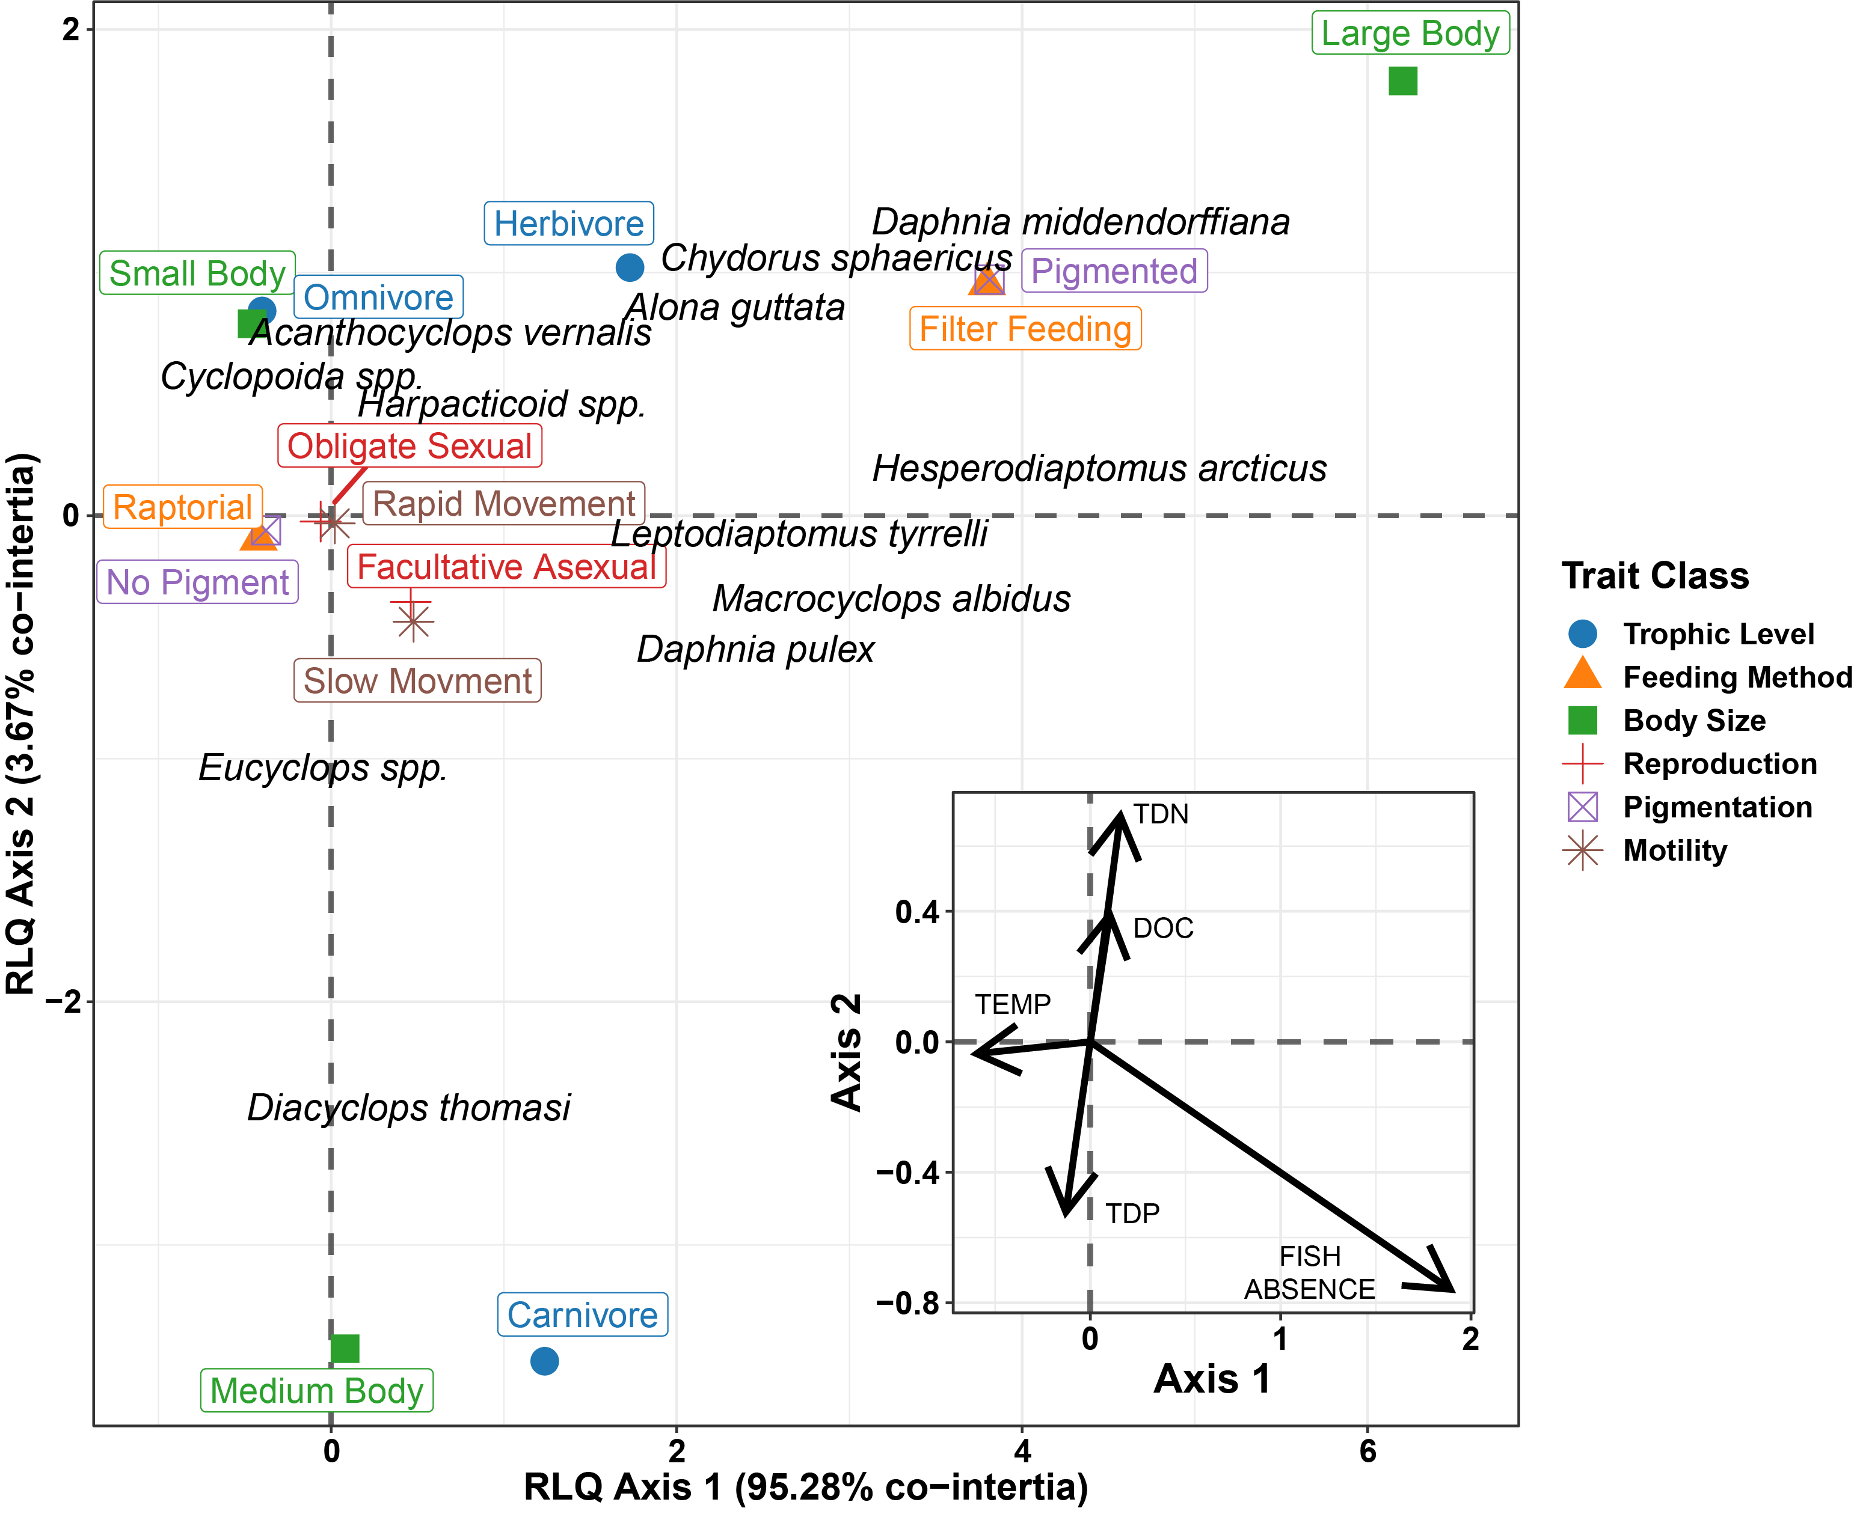
RLQ
Notes:
RLQ ANALYSIS
Total inertia: 0.249
Eigenvalues:
Ax1 Ax2 Ax3 Ax4 Ax5
2.373e-01 9.131e-03 2.412e-03 2.163e-04 4.830e-06
Projected inertia (%):
Ax1 Ax2 Ax3 Ax4 Ax5
95.27614 3.66651 0.96856 0.08684 0.00194
Cumulative projected inertia (%):
Ax1 Ax1:2 Ax1:3 Ax1:4 Ax1:5
95.28 98.94 99.91 100.00 100.00
Eigenvalues decomposition:
eig covar sdR sdQ corr
1 0.237273334 0.4871071 1.329346 0.7364750 0.4975403
2 0.009130988 0.0955562 1.115294 0.5042159 0.1699232
Inertia & coinertia R (ENV.Hill.22):
inertia max ratio
1 1.767162 2.312596 0.7641462
2 3.011043 3.591119 0.8384694
Inertia & coinertia Q (Trait.ACM.22):
inertia max ratio
1 0.5423955 0.7688417 0.7054710
2 0.7966292 1.0599812 0.7515503
Correlation L (Abund.CA.22):
corr max ratio
1 0.4975403 0.9229556 0.5390729
2 0.1699232 0.4999091 0.3399083
MONTE-CARLO TESTS
Number of tests: 2
Adjustment method for multiple comparisons: none
Permutation number: 49999
Test Obs Std.Obs Alter Pvalue
1 Model 2 0.2490375 6.4475956 greater 0.00008
2 Model 4 0.2490375 0.3206315 greater 0.31614

Slide 8
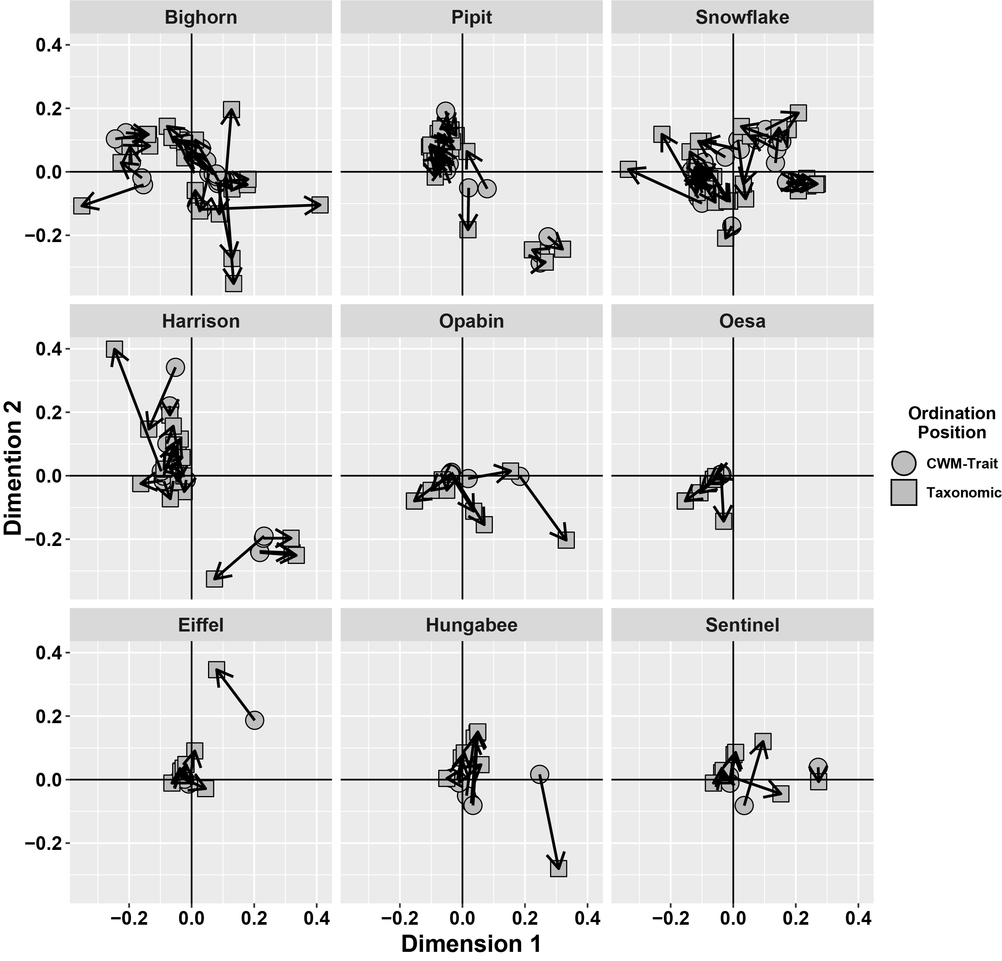
Procrustes positions (Traits -> Taxonomic)
Notes:
BIGHORN LAKE PROCRUSTES:
Procrustes Sum of Squares (m12 squared): 0.569584
Correlation in a symmetric Procrustes rotation: 0.656061
Significance: 0.002
Permutation: free
Number of permutations: 999
PIPIT LAKE PROCRUSTES:
Procrustes Sum of Squares (m12 squared): 0.0657123
Correlation in a symmetric Procrustes rotation: 0.966586
Significance: 0.001
Permutation: free
Number of permutations: 999
SNOWFLAKE LAKE PROCRUSTES:
Procrustes Sum of Squares (m12 squared): 0.390189
Correlation in a symmetric Procrustes rotation: 0.780904
Significance: 0.001
Permutation: free
Number of permutations: 999
HARRISON LAKE PROCRUSTES:
Procrustes Sum of Squares (m12 squared): 0.348426
Correlation in a symmetric Procrustes rotation: 0.807201
Significance: 0.001
Permutation: free
Number of permutations: 999
REFERENCE LAKE PROCRUSTES:
Procrustes Sum of Squares (m12 squared): 0.692549
Correlation in a symmetric Procrustes rotation: 0.554483
Significance: 0.001
Permutation: free
Number of permutations: 999

Slide 9
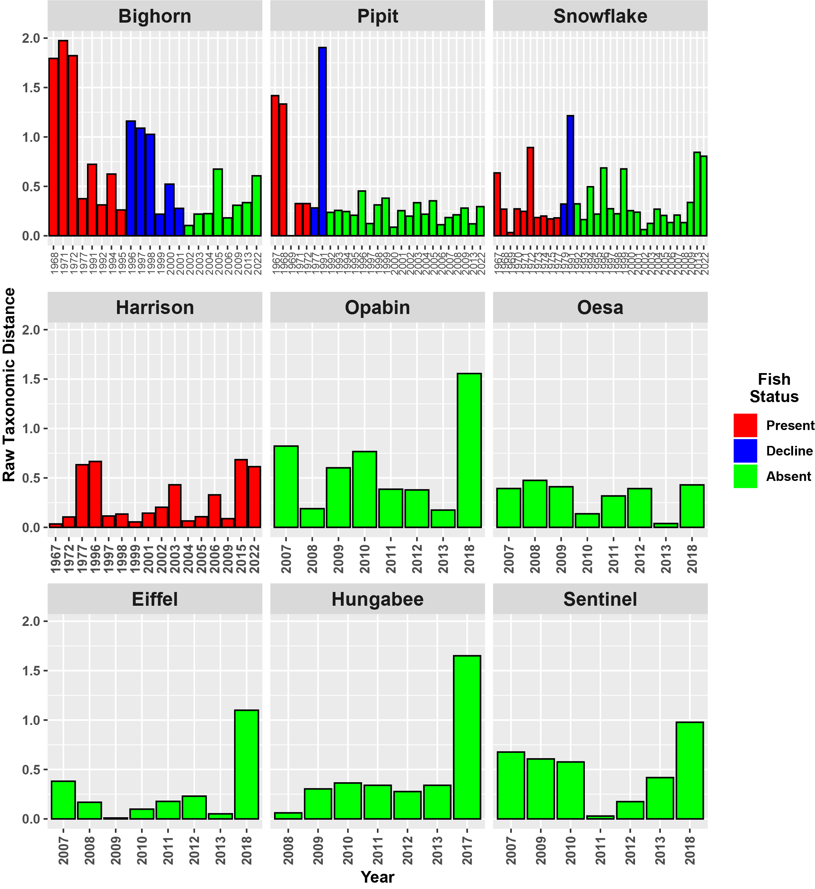
Taxonomic Distances

Slide 10
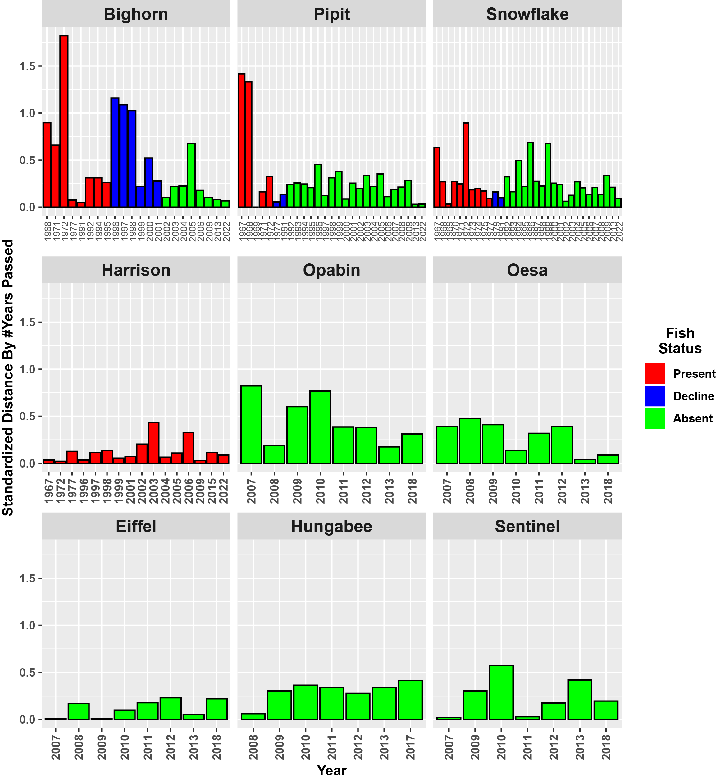
Taxonomic Distances

Slide 11
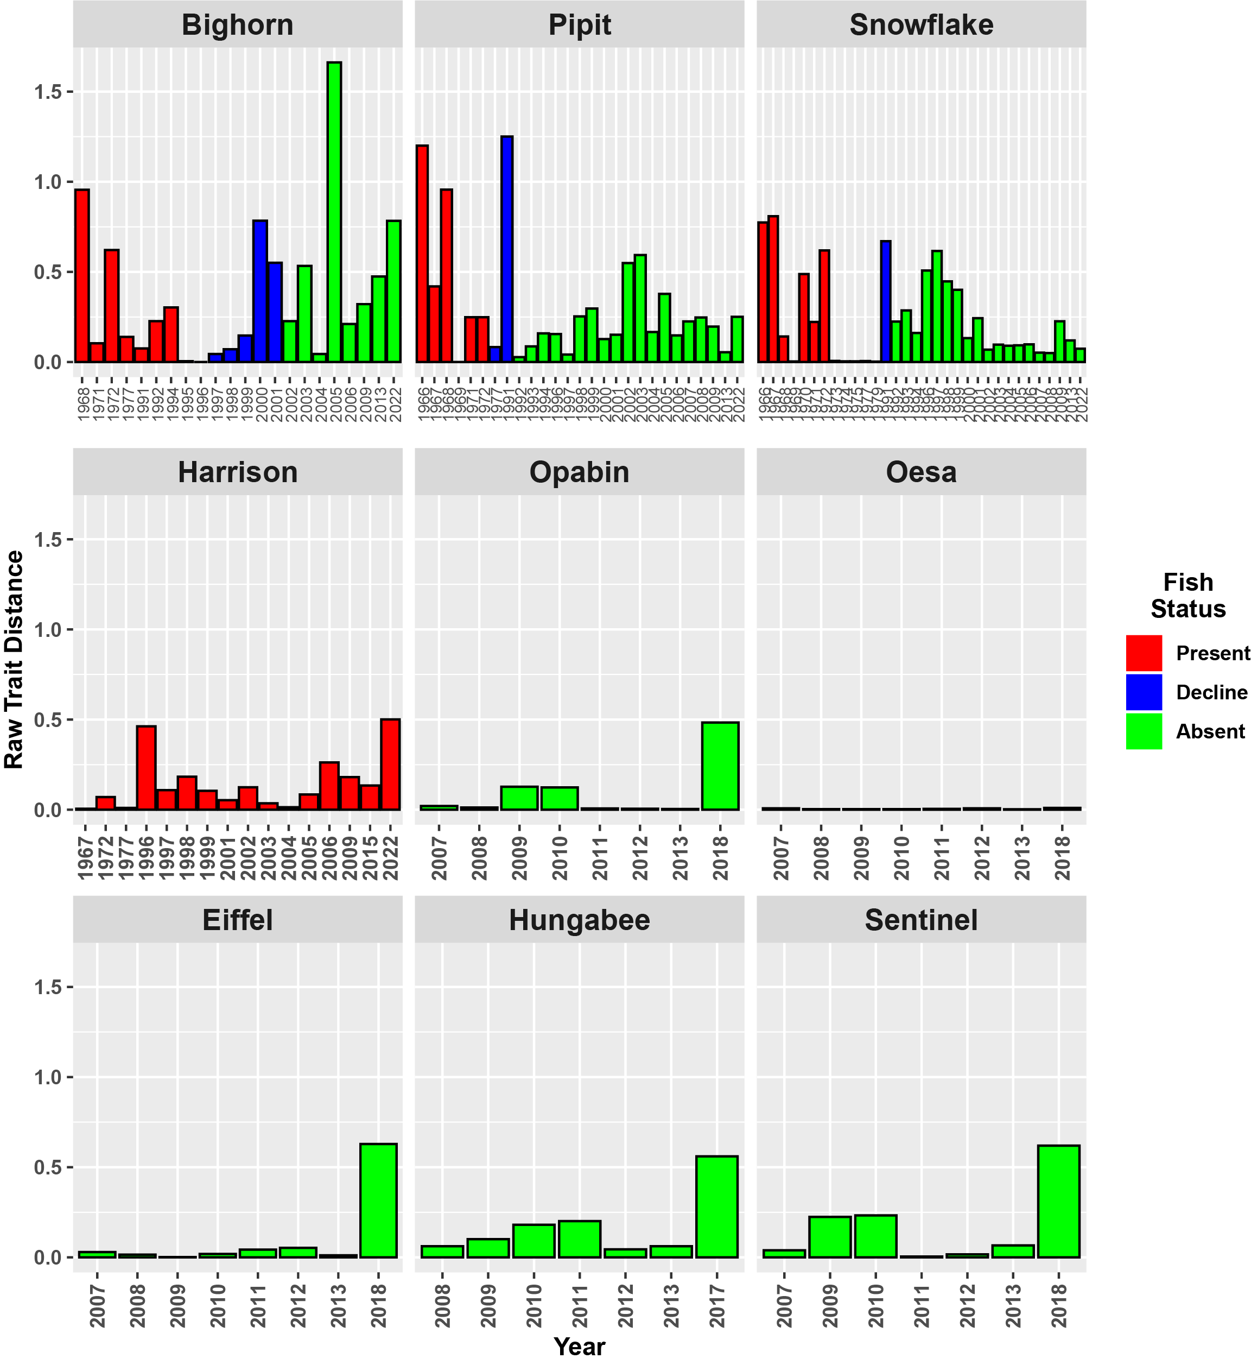
Trait Distances

Slide 12
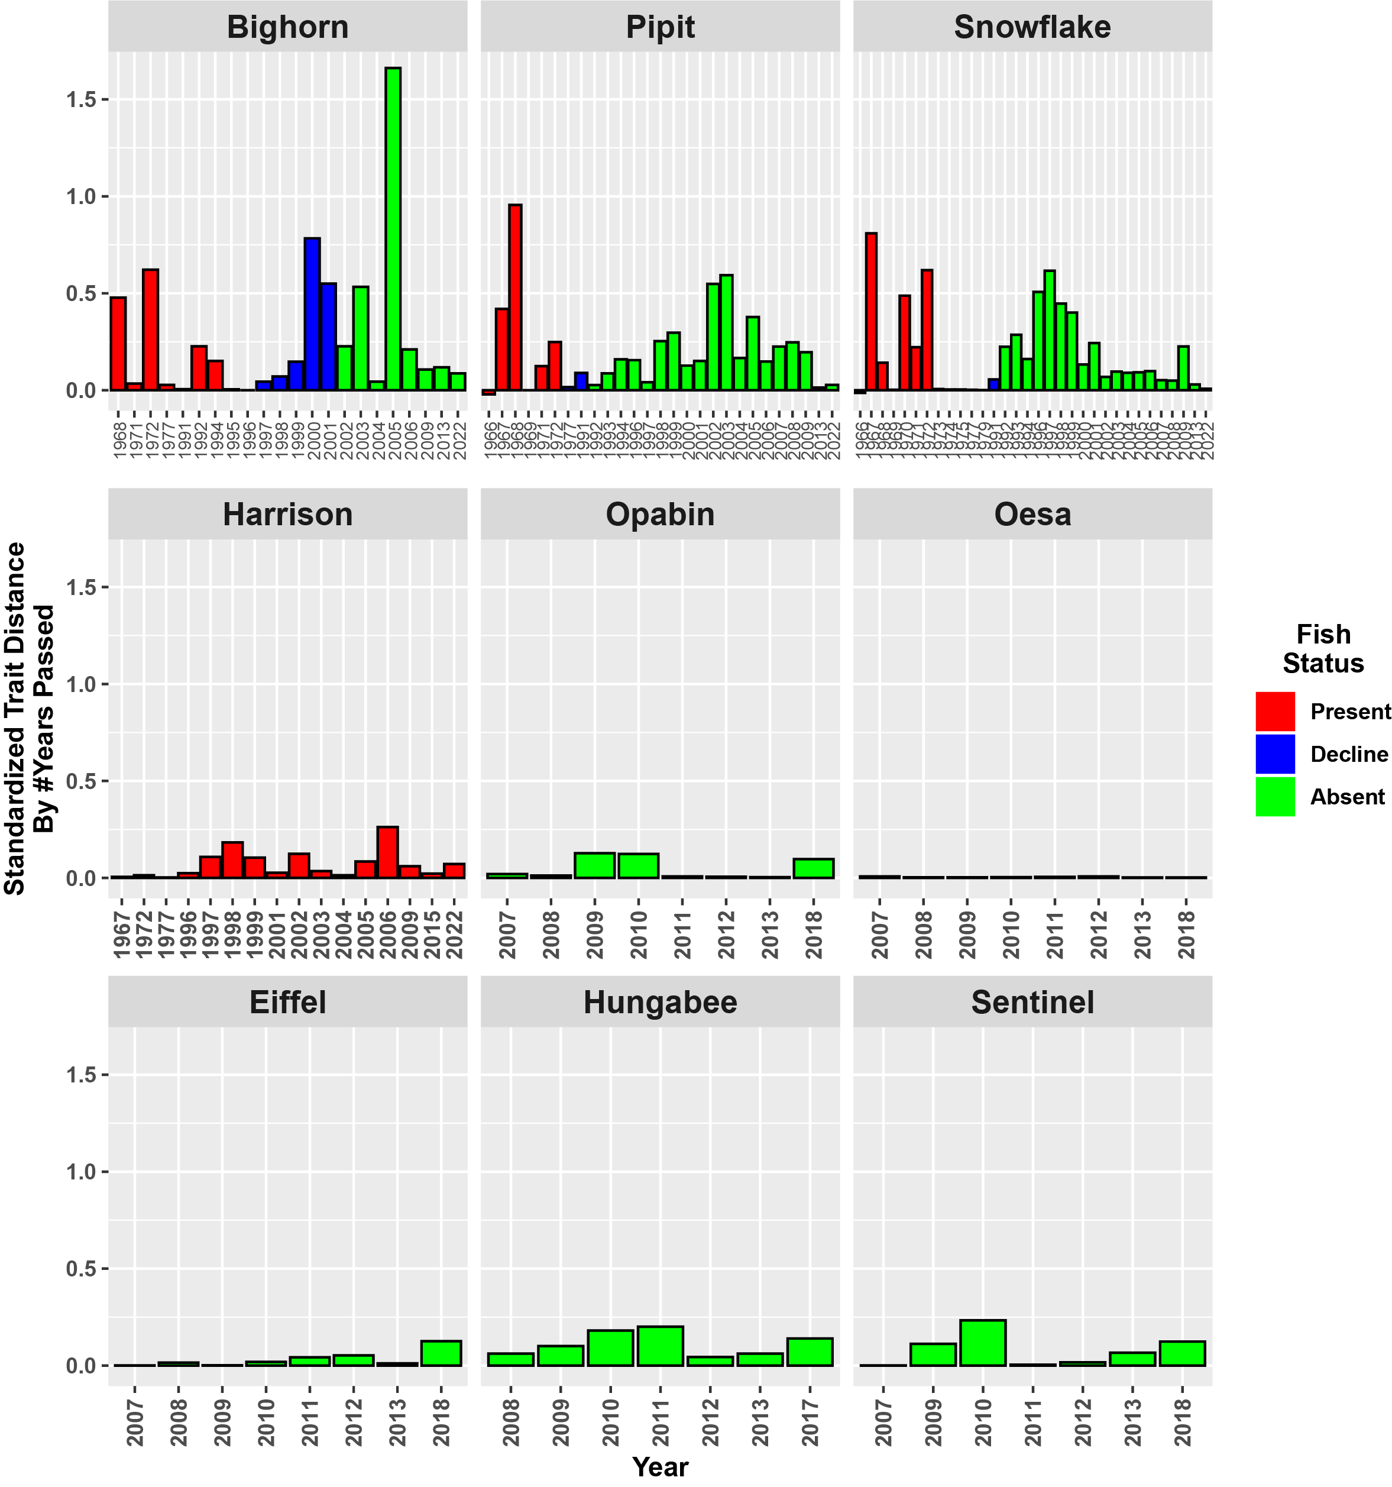
Trait Distances

